Slide 1
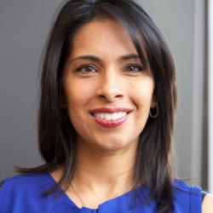
My Biotechnology Role Model Professor Sangeeta Bhatia Scientist Inventor Entrepreneur
Brown University (B.S.)
Massachusetts Institute of Technology (M.S., Ph.D.)
Harvard Medical School (M.D.)
Presented by:
Buwanaji imesha Dias NagahawattE
HS26200917
Assignment 3 – Career Trajectory in Biotechnology

Slide 2
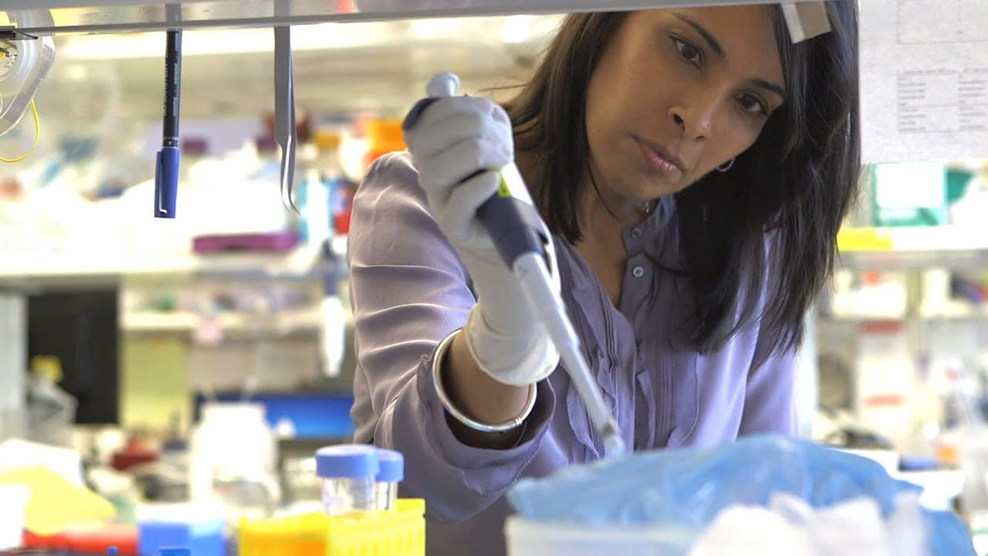
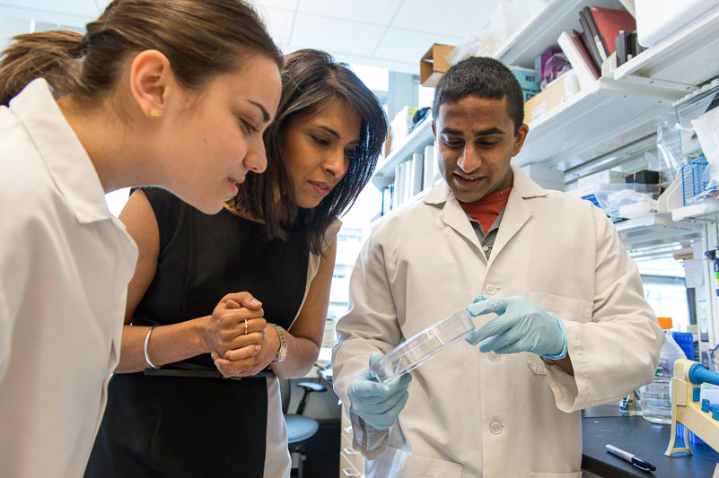
WHY I CHOSE HER
Scientist, Professor, Inventor & Entrepreneur
Combines scientific research with real-world applications
Connects biotechnology with business and innovation
Inspires women in science and biotechnology entrepreneurship

Slide 3
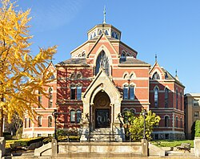
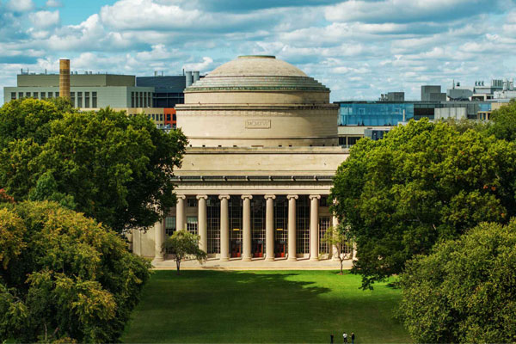

EDUCATION AND CAREER JOURNEY
Brown University MIT Harvard
(B.S.) (M.S. & Ph.D. ) (M.D.)
Biomedical Engineering Engineering + Medicine + Biology Professor & Researcher at MIT

Slide 4
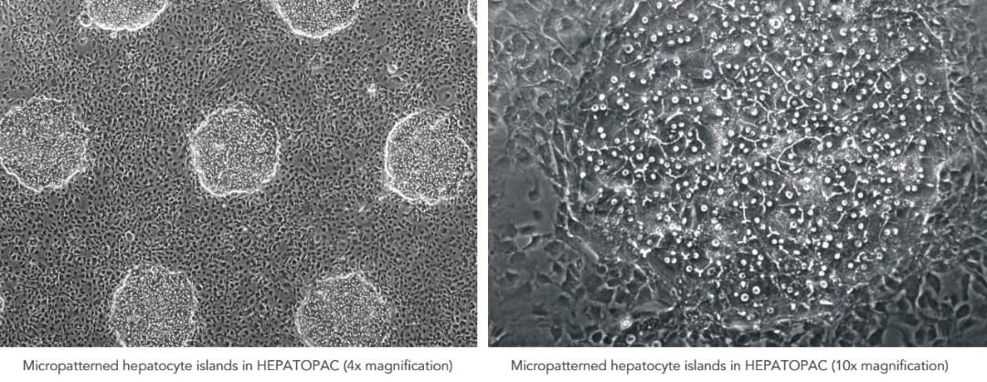
Biotechnology Contributions
Biomedical research
Cancer research
Liver disease research
Disease detection
Regenerative medicine
Biotechnology technologies
Real-world medical applications
HepatoPac®
An engineered human liver model used for drug testing and toxicity studies.
Turning biotechnology research into real-world solutions

Slide 5
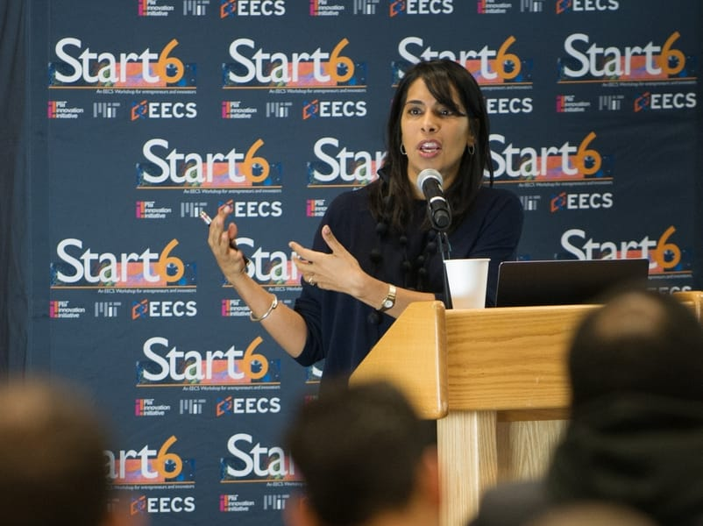
My Career Trajectory
Biotechnology entrepreneur
Turns research into products
Biotechnology businesses Communication
Leadership
Teamwork & collaboration
Supports women in biotechnology entrepreneurship

Slide 6
Major Career Awards
Lemelson-MIT Prize (2014): Awarded this $500,000 prize—often dubbed the "Oscar for inventors"—for her groundbreaking work in miniaturized technologies and dedication to mentoring.
Heinz Award (2015): Received the 20th Heinz Award in the Technology, Economy, and Employment category for her seminal contributions to tissue engineering, disease detection, and her advocacy for women in STEM.
Othmer Gold Medal (2019): Honored for her outstanding heritage contributions to progress in chemistry and science.
David and Lucile Packard Fellowship (1999–2004): Awarded early in her academic career to support creative, unrestricted scientific research.
Global Indus Technovator Award: Recognized for leverageable technology contributions impacting humanity.

Slide 7

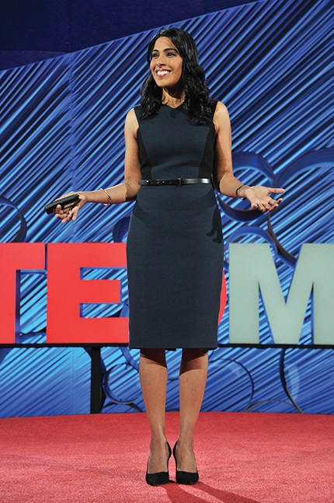

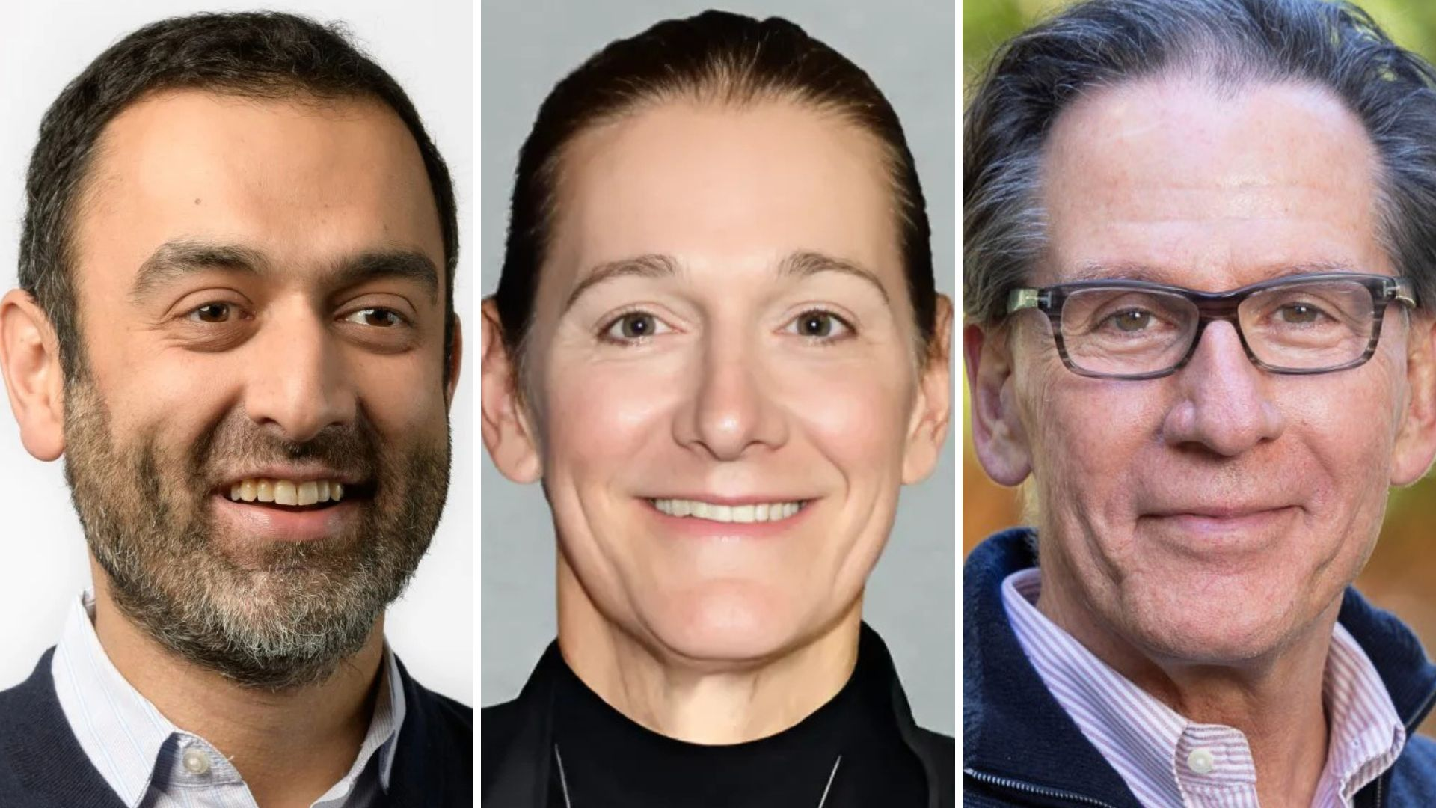
Reflection and Conclusion
Short Term
Biotechnology knowledge
Practical skills
Communication
Internship
Medium Term
Postgraduate education
Industry experience
Business skills
Leadership skills

Slide 8
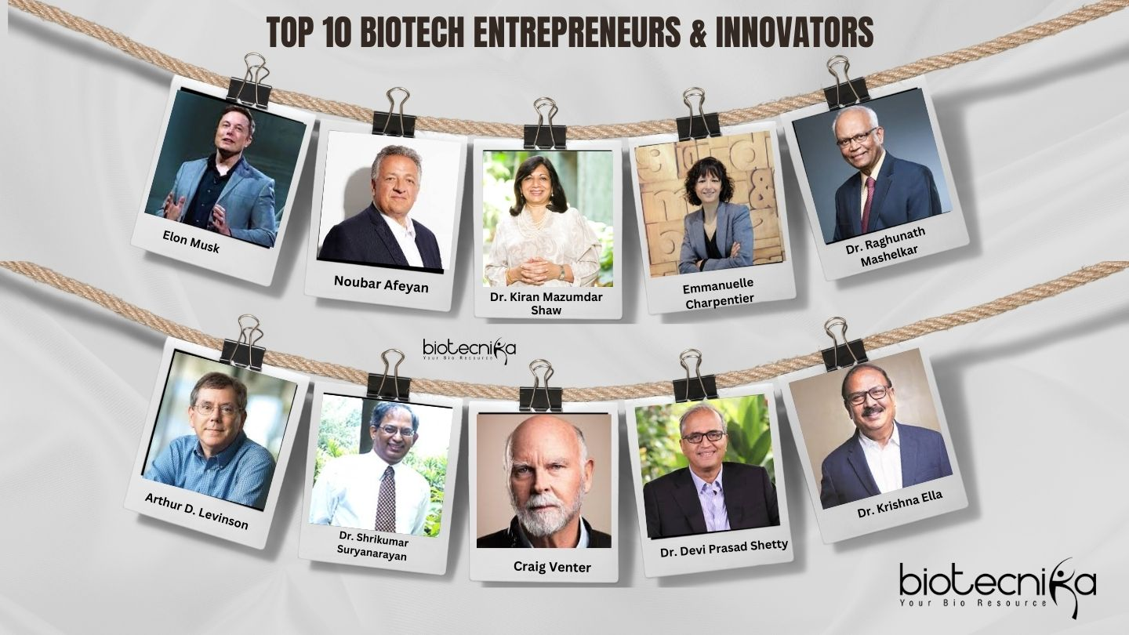

Long Term
Biotechnology leader
Bioproducts
Entrepreneurship
Reflection: Biotechnology is more than laboratory work.

Slide 9
References
MIT – Faculty Profile: Sangeeta N. Bhatia
Used for her education, career, research, patents, biotechnology companies, and achievements.
MIT Faculty Profile – Sangeeta Bhatia⁠
MIT Technology Licensing Office – Sangeeta Bhatia
Used for her entrepreneurship, biotechnology technologies, nanosensors, human microlivers, and companies.
Used for her degrees, research background, inventions, entrepreneurship, and role at MIT.
MIT IMES – Sangeeta Bhatia⁠
Lemelson-MIT – Sangeeta Bhatia
Used for her background, childhood, inspiration, inventions, biotechnology work, and Lemelson-MIT Prize.
Lemelson-MIT – Sangeeta Bhatia⁠
Lemelson MIT
Harvard Wyss Institute – Sangeeta Bhatia⁠
Wyss Institute
A detailed source covering her early life, education, inventions, entrepreneurship, and scientific journey.

Slide 10
THANK YOU

